Slide 1
NO BENEFIT OF KEEPING HAIR UNCUT
Dr Gurbaksh singh

Slide 2
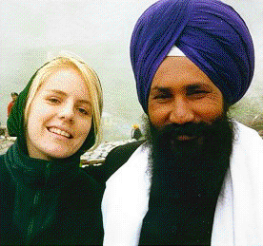
“Why important is for the youth to live the traditional Sikh way of life, retaining uncut hair and wearing turban.”
what is the benefit of keeping hair uncut?”
Does the beard bear mangoes?
The phrase means of what use is the beard to a Sikh ? Why should we keep it ?
If the length of one ‘K’ (kirpan) can be reduced from its normal three-foot size to less than six inches for the comfort of wearing it, why can we not reduce the length of the second ‘K’ (kesh) to a few inches, which is more convenient and comfortable?

Slide 3

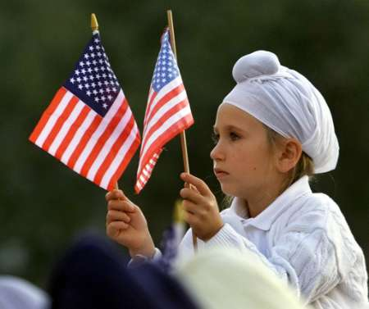
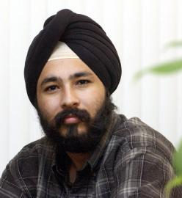
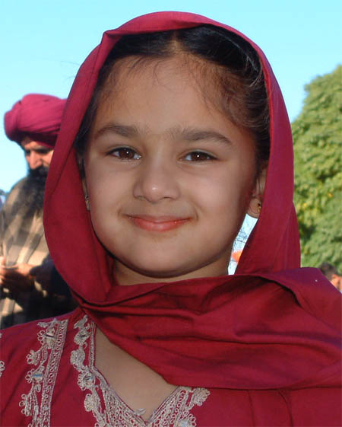
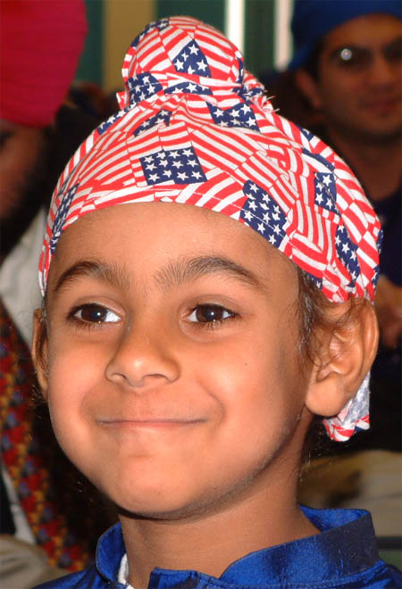
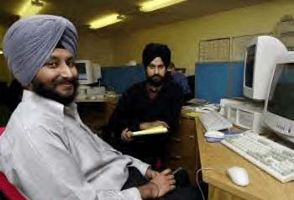
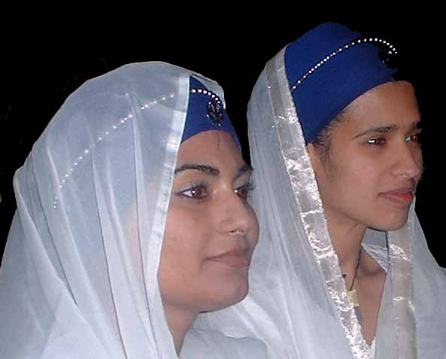
To help them get over their averse feelings towards Sikh Rahit. I responded, “Who told you that keeping a beard provides any benefit I can tell you the benefit of obtaining a medical degree, an engineering degree, doing business etc.
How can a beard give any benefit to anyone?
Look at my beard! I never got a single penny by shaking it, nor have I ever found any dollar hanging from it.
Dear friends, don’t start keeping beard with the hope of getting any benefit from it.”
Youth: Then why are we told to keep beards (uncut hair)?
Notes:
Sikhs have lived in America for more than 100 years, and have contributed to our great nation in a variety of ways.
Today, you will find Sikhs in nearly every business and profession, serving their communities as physicians and taxi drivers, gas station attendants and rocket scientists, business leaders, community volunteers and teachers.
Sikh children attend schools and play sports with the descendents of other great pioneers from all across the world, and they are Americans.
Sikhs are permanently woven into the fabric of America, and are proud to be Americans.

Slide 4
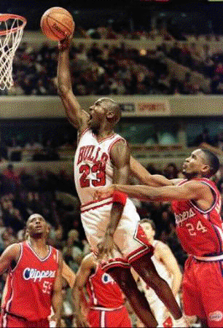
Your uniform is different
Pointing towards a tall student, I asked, “Are you a member of any sports team?”
students replied, “Yes, he is our basketball player.”
I told him, “During the next game, I will come wearing my 1945 jersey and join your team. We will…..”
other boys argued, “No, you cannot join our team. Your uniform is different from that of our team.”
I retorted, “But my uniform is superior to that of his team; mine is a college uniform and his is a school uniform. Rather, they should welcome me.”

Slide 5

Every team has its own uniform different from others
one boy questioned me, “You are the dean of your college, and you don’t know even this simple fact that every team, has its own uniform different from that of all others?”
I stated in a serene voice, “You are my teacher; today I have learnt a lesson of my life from you.
Before I left for my studies in USA, my mother advised me not to cut my hair, irrespective of the problems I might encounter.
Her orders to me were : ‘If they want you to cut your hair, return home with beard and turban. We do not need your Ph.D., if you have to barter your turban (Sikh sroop) for it.”

Slide 6
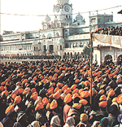
unique team, the Khalsa Panth.
“Yes, my mother told me not to cut my hair because our ancestors got their neck cut but not their hair.
Dear youth, she did not tell me the reason behind this but today you have given me the answer.
If a Sikh removes his turban and cuts his hair, and thus gives up his identity, he can no more claim membership of the unique team, the Khalsa Panth.
The Guru founded this ‘Team’ to live upright and play the game of life to protect the human rights of the weak and helpless irrespective of their caste or creed

Slide 7
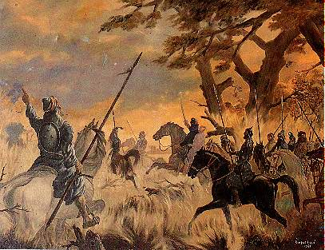
You know that whenever the invaders attacked India, they carried with them not only their loot of the Indian wealth, but also the young women and men, the honor of India, as prisoners.
In Afghanistan, they were sold as slaves just for a coin. The Khalsa attacked the caravan of the invader, Abdali, and got as many prisoners free as possible, of course, at the cost of their own heads.
Later, they escorted the freed prisoners safely to their parents (Hindu or Muslim) in Delhi.
In 1761, Abdali had to fight a bitter battle against Marhattas in Panipat before he could reach Delhi.
While he was returning to his country through Panjab, Sikhs rescued more than 2000 prisoners (mostly women) who were taken back safely to their parents in Delhi.

Slide 8
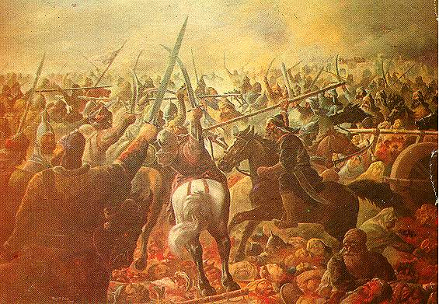
To take revenge on the Khalsa and eliminate them from the face of the earth, in 1762 Abdali brought a specially trained cavalry from Kabul, Afghanistan. The Khalsa were in a very vulnerable position with women, children, and old people.
They were caught unaware while moving from Ludhiana towards safe places in the desert regions.
Almost half the Sikh nation lost their lives (about 20,000 Sikhs were martyred[for the ‘crime’ of saving the honor of the helpless women of the tyrannical Delhi rulers.
This is known as wada ghalughara, the Sikh holocaust of 1762, in Sikh history

Slide 9
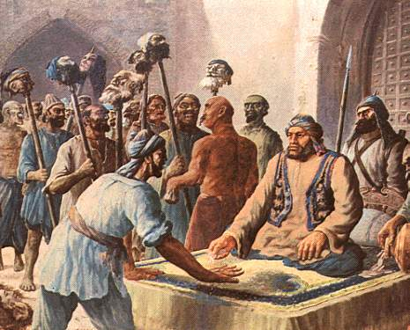
. The Sikh nation, thus, paid the heaviest price for protecting the honor of the country; however, the Khalsa continued serving the weak, irrespective of their faith or caste.
Not only the families of the released women but all people in Panjab nurtured sympathy, respect, and love for the Sikhs, and voluntarily many embraced the Sikh faith.
Therefore, not only Hindus, but also ruling Muslims (Zalam Khan of Sirhind became Zalam Singh) were proud to join the Khalsa even though big awards were offered for the heads of the Khalsa.

Slide 10
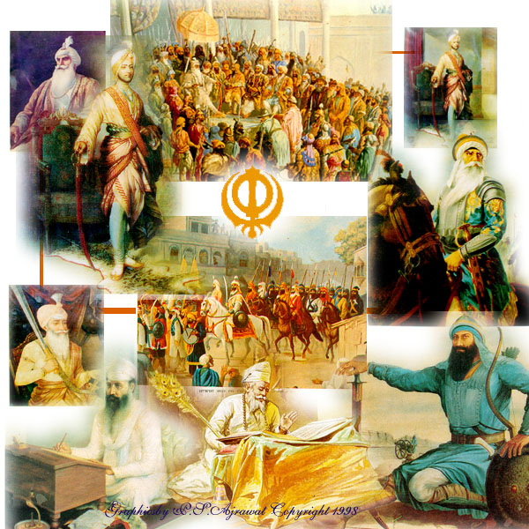
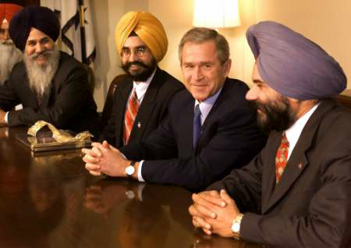
After removing one’s beard and turban, a person no more can claim to be a member of the Khalsa Panth.
The result of the high character of the Khalsa was that they became the rulers of Panjab.
He loses the honor of this unique heritage earned through unparalleled sacrifices.

